Slide 1
Module 26: Configuring Drilldowns
Siebel Core Developer and Technology School
Notes:
Time: Lecture: 25 minutes; labs: 30 minutes
Intent: To teach students how to create and configure some of the navigational aids in Siebel applications.
Flow: Static drilldown, dynamic drilldown, thread bar; and applet toggling.
Key Terms:
Applet toggle (object definition)
Dynamic drilldown
Dynamic toggling
Static drilldown
Static toggling
Thread applet
Thread field
Threadbar (tag)
Togglebar (tag)
Please note: Faculty-specific notes are italicized.

Slide 2

Module Objectives
After completing this module you will be able to:
  Configure drilldown to a related view
  Enable the thread bar
Why you need to know:
  Enables you to add drilldowns to assist users with navigation
  Enables you to activate the thread bar to assist users

Slide 3
Navigation Using Drilldown
You can configure list columns for drilldown
  When the user clicks the hyperlinked value, the application navigates to another view
You can configure drilldown as static or dynamic
  Static: Clicking the hyperlink always navigates to the same target view
  Dynamic: Clicking the hyperlink navigates to a target view determined by values shown in the current view
Notes:
This is a positioning slide for concepts regarding drilldown. The next series of slides will show how drilldowns appear inside the application and how to implement them using Siebel Tools.
A drilldown (you may also hear the term “view drilldown”) is like a hyperlink on a Web page. The user clicks a field in the record and is taken to another view. Static drilldowns are called “static” because you always arrive at the same destination view, no matter what the value is of the field that was clicked. Dynamic views are “dynamic” because the value of the field determines which of a possible number of potential destination views the user sees next.
Diagram idea: It might be useful here to draw a simple representation of static versus dynamic on the board so students can have it to refer to as you go through the slides.
Static: Draw views A and B on the board, with fields F1, F2, and F3 in view A. Draw an arrow from F1 to view B to represent the user drilling down on F1 and being taken to view B.
Dynamic: Draw views A, B, C, and D on the board, with fields F1, and F2 in view A. Draw an arrow with two “tails” from F1 and F2 to view B, to show that if certain values appear in F2, drilling down on F1 takes the user to view B. Draw another arrow with two “tails” from F1 and F2 to view C to represent another conditional drilldown. Finally, draw a simple arrow from F1 to view D, showing the default drilldown if no other conditions are met.

Slide 4
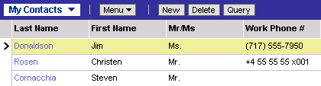
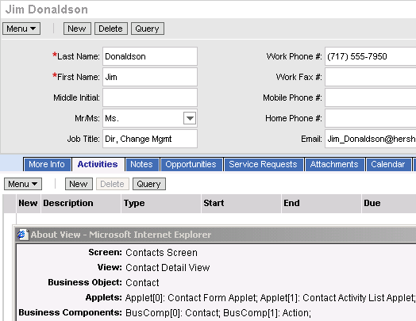
Static Drilldown: Same Business Component
Drill down to another view, keeping the business component (BC) context
Contact record in Visible Contacts list view
Same contact record in Contact detail view
Notes:
This slide defines static drilldown within the same business component. Note that static drilldown within the same business component is most frequently seen in the list applet of a More Info view.
The screen shot shows a static view drilldown implemented in the Contact list applet (on the left). Point out that the contact of the record is maintained. The drilldown was configured on the Last Name field, not the First Name field, and the drilldown action navigates to a view where the information is based on the same business component as the business component from which we are drilling down.
This module shows three different ways to configure drilldown, from least complex to most complex.
Follow these steps to demo static drilldown:
1. Log in to Siebel Call Center as SADMIN connecting to the sample database.
2. Select Contacts > My Contacts and use the Last Name field (same as the screen shot). Point out that the drilldown field can be identified by the blue color on the hyperlinked text. Also, point out that when you hold the mouse pointer over the field, it will display a blue underline and the mouse pointer changes to a hand. Show how clicking takes you to a different view.

Slide 5
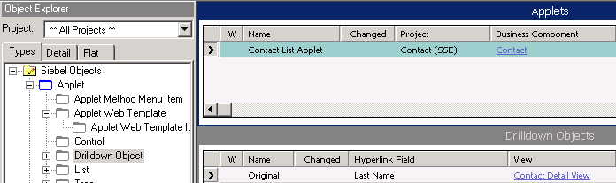
Configuring Drilldown
Create a new drilldown object
  Set the Hyperlink Field and View properties to enable static drilldown
Specifies BC field to be highlighted for drilldown
Specifies the target view
Notes:
This slide shows how to configure the definition for a static drilldown within the same business component. The screenshot shows how the drilldown illustrated on the previous slide is configured.
Let’s use the example in the previous slide to create a new static drilldown. A user navigates to the specific applet object and selects the child object “Drilldown Objects” in the object explorer. The example uses the Contact List Applet.
A user then needs to specify the desired field to be drilled down, in this case that field is “Last Name” as well as the desired navigation view, which is the “Contact Detail View”. In this example the name of the drilldown object is “Original”, original is the vanilla name Siebel uses. The name of the drilldown object can be anything, as long as it is unique in that applet.

Slide 6
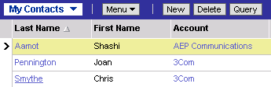
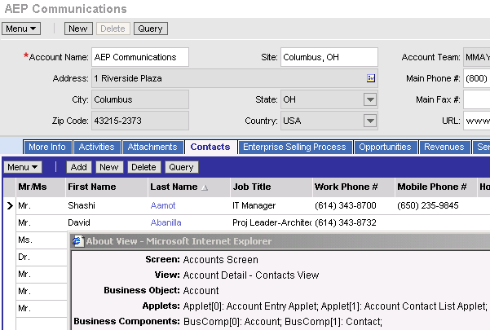
Static Drilldown: Different Business Component
Drill down to another view, changing the business component context
Account field of contact record in Visible Contacts list view
Related account record in Account Detail - Contacts view
Notes:
This slide defines static drilldown to a different business component. Whether a drilldown is static or dynamic is a different issue from whether or not the same or different business components are involved.
In the screenshot, our starting context is on the Contact List Applet inside the Visible Contact List view. Then, we drill down to the Account Form Applet inside the Account Detail - Contacts view. So our context has moved from the Contact business component to the Account business component.
Select Contacts from the screen tab and then drill down on the Account field to navigate to the Account Detail-Contacts view.

Slide 7
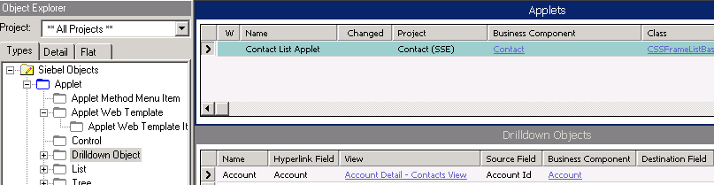
Configuring Drilldown to Different Business Component
Create a new drilldown object for the applet
  Set Hyperlink field and View properties as before
  Set Business Component, Source Field, and Destination Field properties to enable drilldown to a view based on a different parent record
Specifies master BC in target view
Foreign Key field in record pointing to target BC
Primary Key field in the target BC
(default is Id)
Notes:
This slide shows the extra properties we need to set in order to configure the definition for a static drilldown to a different business component. The screenshot shows how the drilldown illustrated on the previous slide is configured.
Note that we have to specify additional information:
The BC to which we are navigating – in this case the Account BC
The name of the foreign key field in that source BC that will match the primary key field in the target BC. In this case, the foreign key field is the Account Id, because the Account Id in the Contact BC is the foreign key to the ROW ID in the Account BC. In this example the destination field is left blank, because it is implied that the destination field is the ROW ID. We only need to populate this field if we use a primary key field other than the implied ROW_ID column.

Slide 8
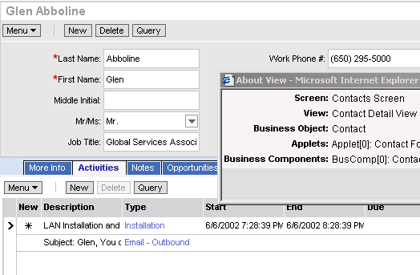
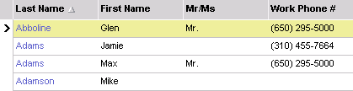
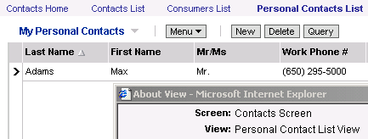
Dynamic Drilldown
Enables drilldown to multiple views from the same hyperlink field, depending on the value of a field in the active record of the list
For business Contacts, go to the Contact Detail View
For Personal Contacts, go to the Personal Contact List View
Notes:
This slide defines dynamic drilldown. Note that dynamic drilldown is generally to a different business component.
Dynamic drilldown navigates the user to multiple views from the same hyperlink field as illustrated in the screenshot.

Slide 9
Matching Conditions
Identify one or more matching conditions to trigger drilling down to a specific target view
  Personal Contact = Y ====> Personal Contact List View
  Personal Contact = N ====> Contact Detail View
Determine the order to check the matching conditions
  Conditions can involve different fields
  Multiple matches could occur for a given record
Notes:
This slide lists some items of business logic the developer should determine before configuring a dynamic drilldown. The developer must specify the conditions to navigate to a particular target view.

Slide 10
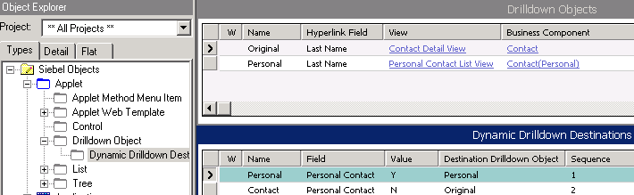
Configuring Dynamic Drilldown
Create the drilldown objects for each view
Create a dynamic drilldown destination definition for each condition
Field to check
Value to check for
Notes:
This slide shows how to configure the definition for a dynamic drilldown. The screenshot shows how the drilldown illustrated two slides previously is configured.
First, you configure a drilldown object for each destination view. These create the set of possible places to go. Each drilldown object also has a sequence number. The conditions that dictate which view is drilled down to are specified in the dynamic drilldown destination (DDD). This is a child object of the drilldown object. You must configure this for the drilldown object with the lowest sequence number, and the best practice is to configure it for all.
The sequence number also enables “priority” for a drilldown object – if the user double-clicks in a row with one or more drilldowns configured, the application navigates based on the drilldown with the lowest sequence number.

Slide 11
Configuring Dynamic Drilldown Continued
Configure the default drilldown object to navigate to the desired view if there are no matches
  If no default is configured, clicking when there is no match does not drill down
Configure a dynamic drilldown destination definition for each condition
  Set the Field, Value, and Sequence properties
  Set the Destination Drilldown Object property for the view to drill down to if a match occurs
Configure additional drilldown objects for each of the special target views
Notes:
This is a checklist of general principles for configuring a dynamic drilldown without unwanted results.
Where do you want users to navigate to when there is no matching condition? The default should always be the last item to check in the sequence, and should have no matching condition. If no default is defined, and no matching condition is met by a given record, the drilldown does nothing (that is, the user continues to see the current view).
Configure a drilldown object that navigates to your target view (that is, set these properties to define the required target/destination view at which users should arrive).
Each target view must be specified in a drilldown object (DO) definition. Each condition (Dynamic Drilldown Destination (DDD)) should point back up to a drilldown object.
If no default drilldown object has been set, and all matching conditions fail, the hyperlink still appears, but it will not navigate to another view. It is a recommended practice to set a default drilldown object to avoid this confusion.

Slide 12

Thread Bar
Tracks previous business object (view) and active record
Updates whenever the user navigates to a different business object or active record
Provides hyperlinks to previous views
  Allows user to backtrack easily
Hyperlink to prior active record in the thread
Notes:
This is a positioning slide for concepts regarding thread bars.
Thread bars track the user’s navigation through views. The thread bar allows a user to navigate easily back to the previous view.
For example, let’s say the user does drilldown on the account name and navigates to the Account Detail View. If the user wants to go back to the contact list applet, they can simply click on the appropriate thread bar to go back to the highlighted contact record.

Slide 13
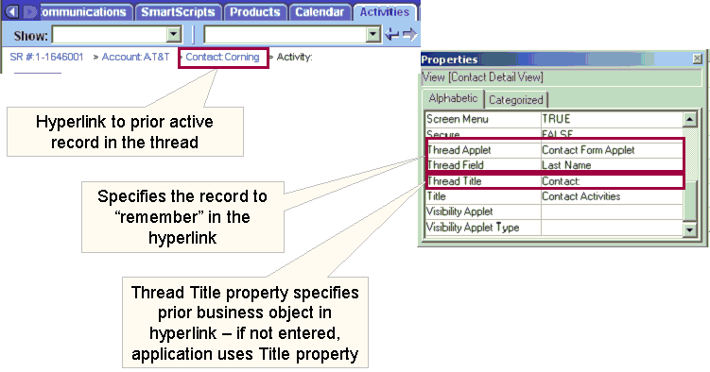
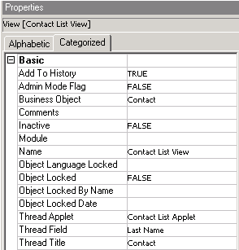
Thread Properties
Specifies the text that appears in the thread bar
Specifies the record to “remember” in the hyperlink
Thread Title property specifies prior business object in hyperlink; if not entered, application uses Title property
Notes:
This slide shows how thread applet and thread field definitions relate to the appearance and behavior of the thread bar.
Note that while drilldown is configured on a field of an applet, thread bar properties are configured on a view.
This example uses the Contact Detail View. The thread applet and the thread field property specifies the record to remember in the hyperlink as well as the thread title represents the prior business object. As you can see in the screen shot on the left, the configured thread bar shows the Contact business object and the last name of the contact that was drilled down. In this example, the last name was Corning.
If a user was to invoke the hyperlink in the thread bar, the user would navigate back to the contact form applet with the contact record of “Corning” highlighted.

Slide 14
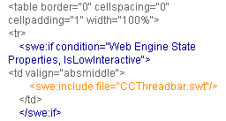
Threadbar Tag
To enable the thread bar, the view template must include a SWE thread bar tag
  Usually included by referencing an external SWT file, CCThreadbar.swt
  For example, to include the thread bar in a view, use
  <swe:include file="CCThreadbar.swt"/>
Excerpt from CCViewDetail.swt – how to include thread bar in view web template
Notes:
This slide shows how a thread bar is implemented in HTML. You don’t need to discuss this in detail, since developers don’t usually code this HTML.
To enable a thread bar, the template associated to the applet must include a thread bar tag. This tag should reference the external CCThreadbar.swt template file. This is just something to note as most developers do not have to include this tag themselves. This tag already exists in all vanilla applet template files.

Slide 15
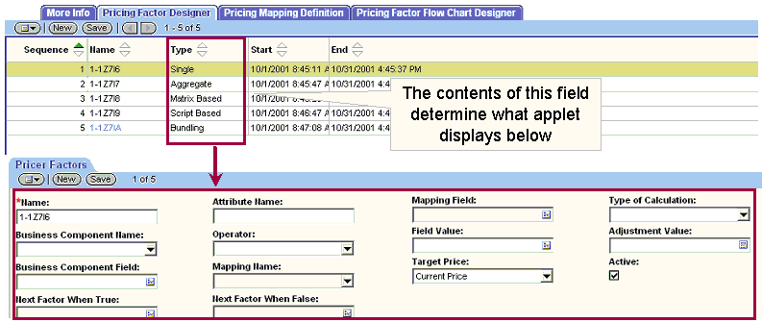
Dynamic Toggling
Determines the applet to appear in a view based on the value in a specific field in the displayed record
Does not use a toggle list
  User does not directly control navigation between applets
Notes:
Dynamic toggling can also be configured in Siebel tools. Dynamic toggling is controlled by the application rather than the user.
This is similar to dynamic view drilldown, in that the applet that appears is determined by the value in a specified field (in the displayed record). For example, the contents of the Type field in the list applet determines what applet is displayed below.

Slide 16
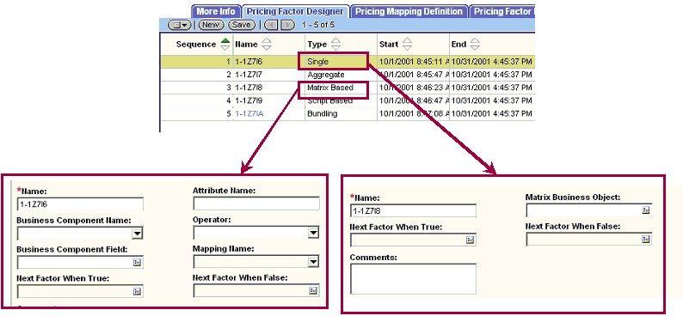
Dynamic Toggling (cont’d)
Example: Changing the Type property of a pricing factor determines which one of several pricing factor detail applets appears
Notes:
In more detail, if the record that is highlighted in the list applet has a type value of Single, then the form applet on the right is displayed. If the user navigates to a record in the list applet with the Type field of Matrix Based, then the form applet on the left is displayed.

Slide 17
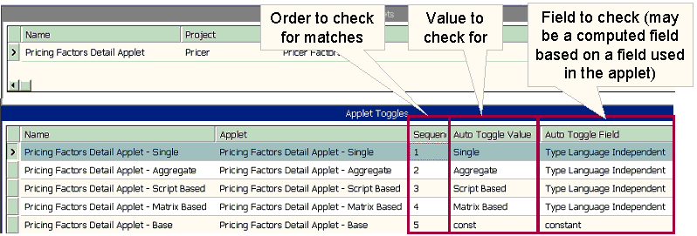
Configuring Dynamic Toggling
Create a child applet toggle for each possible applet
  Set the Auto Toggle Field, Auto Toggle Value, and Sequence properties
  Child applets must be based on same business component as parent
Set the parent applet as the default to display when all conditions fail
Notes:
Let’s look at how to configure the definition for a dynamic applet toggle. The Screenshot shows how the toggle illustrated on the previous two slides is configured.
The important attributes to consider are Auto Toggle Value and the Auto Toggle Field. The Auto Toggle field is the field name and the Auto Toggle Value is the value to check for that specific field. In the first applet toggle, the field is Type Language Independent, and the value and if the auto toggle value is Single, we then want to make sure that the Pricing Factors Detail applet – Single is invoked. Again the sequence attribute determines priority since multiple matches may occur if different field names are used.

Slide 18
Summary
This module showed you how to:
  Configure drilldown to a related view
  Enable the thread bar
Notes:
Review Question: What are the three kinds of drilldown?
Answer: Static drilldown within the same business component, static drilldown to another business component, and dynamic drilldown
Review Question: Drilldown is configured on what type of object?
Answer: On a column of a list applet
Review Question: On what type of object is the thread bar configured?
Answer: On a view object

Slide 19
Lab
In the lab you will:
  Create and configure dynamic drilldowns
  Enable and configure thread support
Notes:
See the lab instructions for details.

